Slide 1

Trends in Open Science in the Humanities
IFoHS Open Humanities” Summer Forum
August 21, 2025
Research Center for Open Science and Data Platform (RCOS), National Institute of Informatics
Makoto ASAOKA

Slide 2
Today's Outline
What is Open Science (OS)?
Changes in Data Sharing
Journals with DAS
Immediate Open Access
Research Infrastructure for the Humanities
Europe/U.S.
Japan
Data Sharing for humanities
Data Management Plan(DMP)
Metadata in the Humanities
Steps for Data Sharing
Outlook
＊The views are my personal opinions

Slide 3
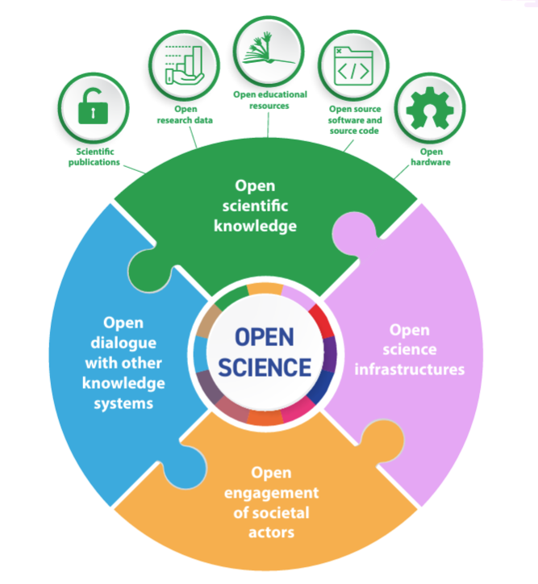
What is Open Science (OS)?
Open science serves to widen access to scientific knowledge for the benefit of science and society. (UNESCO, 2023).
Open access to scientific knowledge
・research articles
・research data
→Narrow Open Science
Open dialogue with other knowledge systems
・Introduction and utilization of traditional knowledge possessed
by indigenous peoples and local communities
Open Science infrastructure
・Repository（archive）
・Research data management system
・Research data discovery database
・Computing System
Open engagement of
societal actors
・New science through citizen participation
・Collaboration with policymakers and businesses
Elements of open science（UNESCO 2021）

Slide 4
Changes in Data Sharing
Before IT developing
Data = community public good, but held by individuals
Safeguard rare datasets; release international comparison data
Sharing limited to representative datasets
After IT developing
Cross-regional & cross-disciplinary sharing
Long-term preservation of digitized heritage; downloadable datasets
Publisher-driven data policies; stronger article–data linkage
Publicly funded results opened by policy
Sharing is becoming the norm

Slide 5
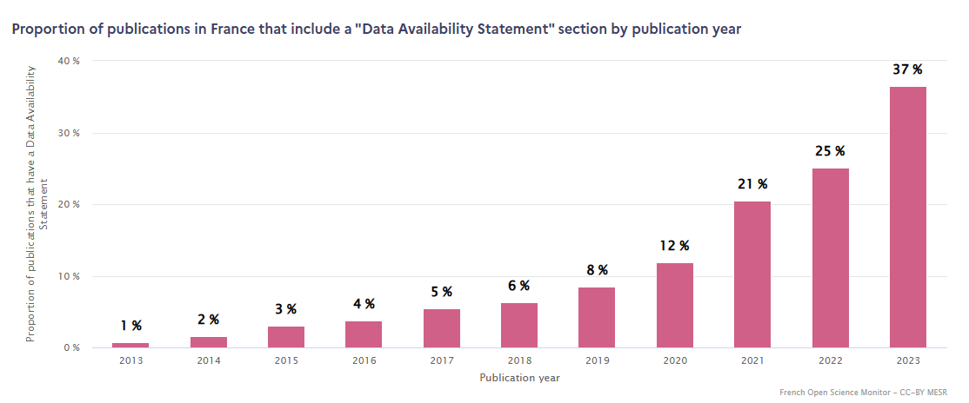
Journals Mentioning Data Sharing (France)
Data Availability Statement（DAS）：
journals recommend or require authors to state how to access the data that support their papers
More journals now require or recommend DAS each year.
Ref: French Open ScienceMonitor(https://frenchopensciencemonitor.esr.gouv.fr/research-data/general)

Slide 6
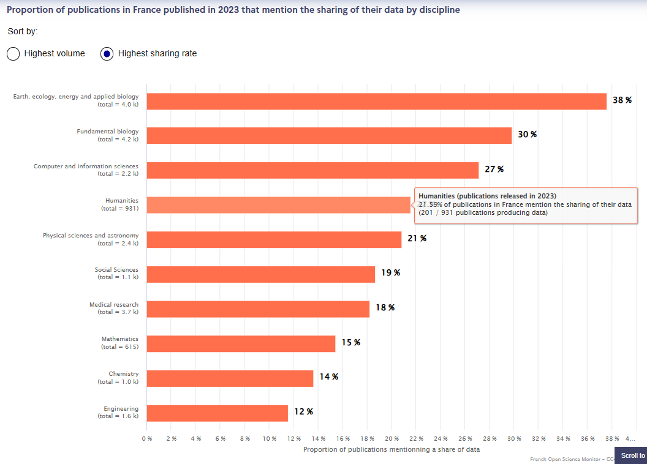
Humanities Journals with DAS
22%
Share of humanities journals adopting DAS (France, 2023)
Ref: FrenchOpen ScienceMonitor(https://frenchopensciencemonitor.esr.gouv.fr/)

Slide 7
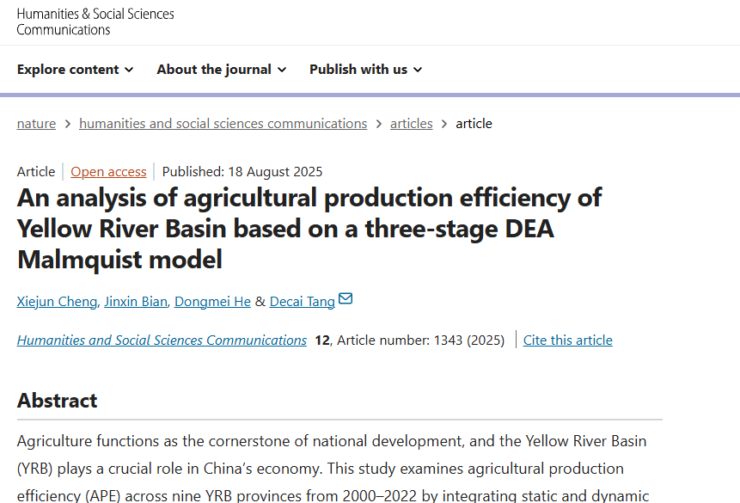
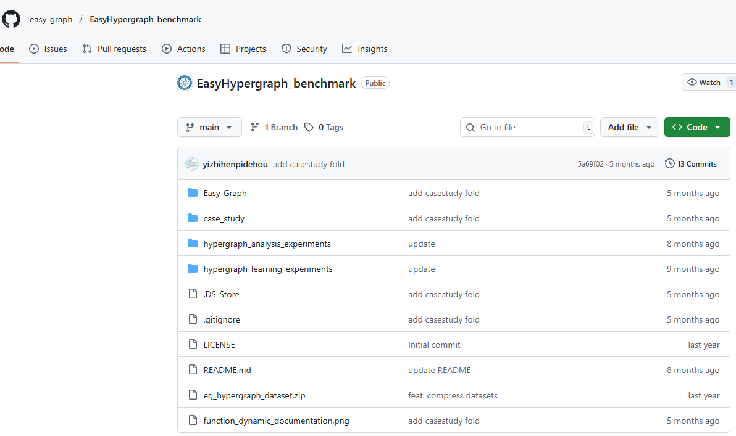
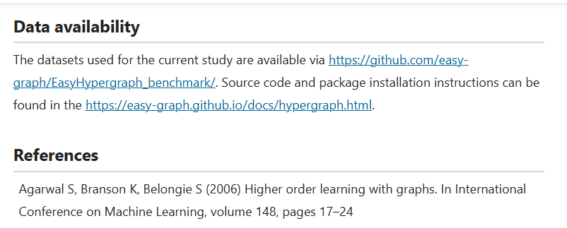
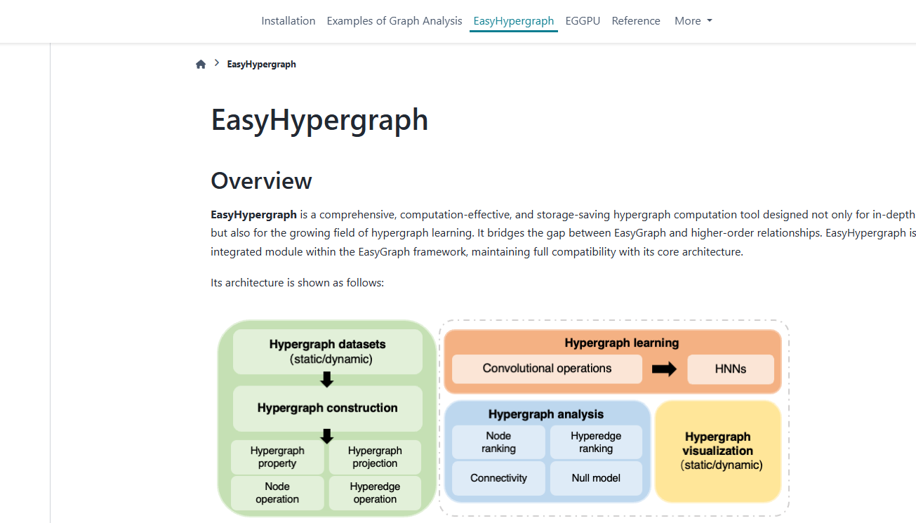
Data Availability Statement（DAS）
Humanities and Social Sciences Communications（Nature Portfolio）
https://www.nature.com/articles/s41599-025-05541-0

Slide 8
“Immediate Open Access “ for Publicly Funded Research
From Plan S onward, open access has accelerated
EU (Sep 2018)
– Plan S announced
From 2021, journal articles from publicly funded research must be open immediately.
Default license: CC BY.
Covered the funders in 11 countries at launch (cOAlition S).
United States (Aug 2022)
– OSTP policy for immediate public access by 2025
No embargo after publication (“immediate OA”).
Applies to peer-reviewed articles and their underlying data.
Japan (Feb 2024)
– Cabinet Office basic policy for immediate OA
From FY2025, for competitively funded projects, peer-reviewed articles and their supporting data must be made open immediately.
Notes:
科学技術政策局（OSTP）

Slide 9
Research Infrastructure for the Humanities in Europe/U.S.
Standardizing Metadata
Common formats capture context for diverse humanities data.
TEI
IIIF
CIDOC-CRM
schema.org
Repositories for Access & Preservation
Publish and preserve digitized resources.
APIs with metadata enable system-to-system exchange.
Europeana / Open Context / DPLA
Challenges: copyright, multilingual support, sustainability.

Slide 10
Research Infrastructure for the Humanities in Japan
Japan
Data sharing occurs through individual institutions, but standardization and interoperability across institutions lag behind.
Slow outreach → missed chances for international collaboration.
Data re-use environments are not yet mature.
⇒ Growing sense of urgency about data infrastructure
JSPS (Japan Society for the Promotion of Science) Program (2018–2023)
Program for Constructing Data Infrastructure for the Humanities and Social Sciences
Five-year effort (FY2018–FY2022).
Commissioned institutions to curate research data and strengthen disciplinary repositories.
Built infrastructure to promote data re-use.
Since Oct 2023
Program for Strengthening Data Infrastructure for the Humanities and Social Sciences
Follow-on phase to reinforce and scale the infrastructure.

Slide 11
What Infrastructure Do HSS Researchers Need?
1) Data discovery for HSS
Search the latest holdings published by multiple institutions
Query with humanities-specific facets (period, region, language, genre, person, corpus, etc.)
2) Environment to run analysis code
Reproduce methods from prior studies
Publish and keep updating analysis code (notebooks / pipelines) with versioning
3) Environment to publish HSS data
Integrated with ① & ② so data can be found, run, and reused
Clear how-to for sharing & publishing research data
Supports Open access and access-restricted release
Notes:
データ生成者

Slide 12

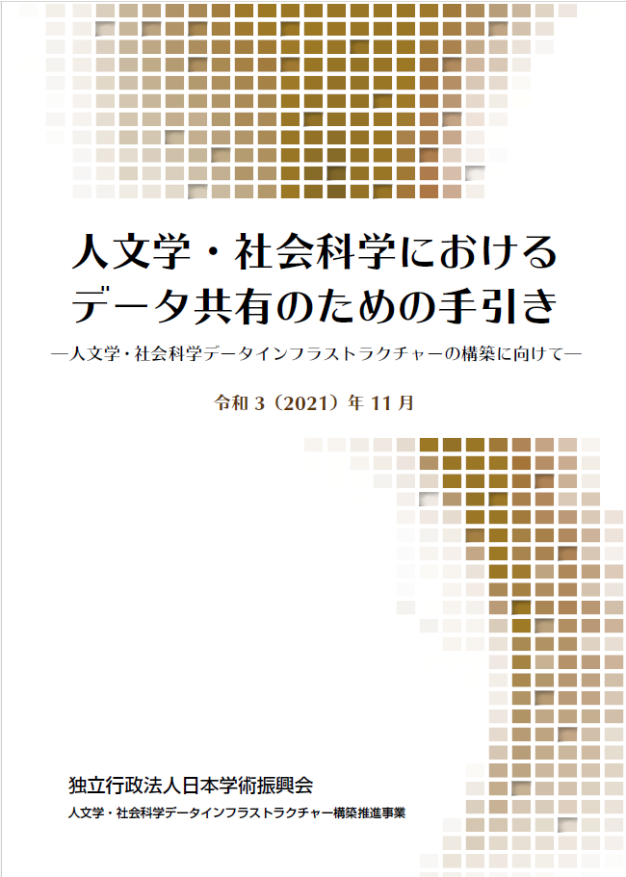
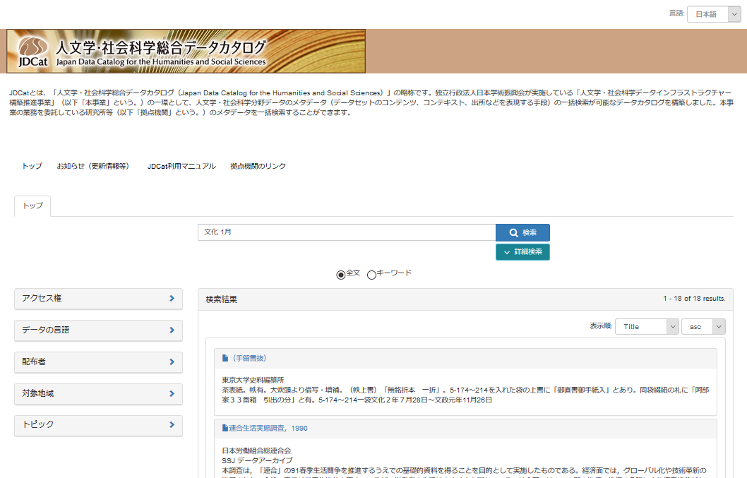
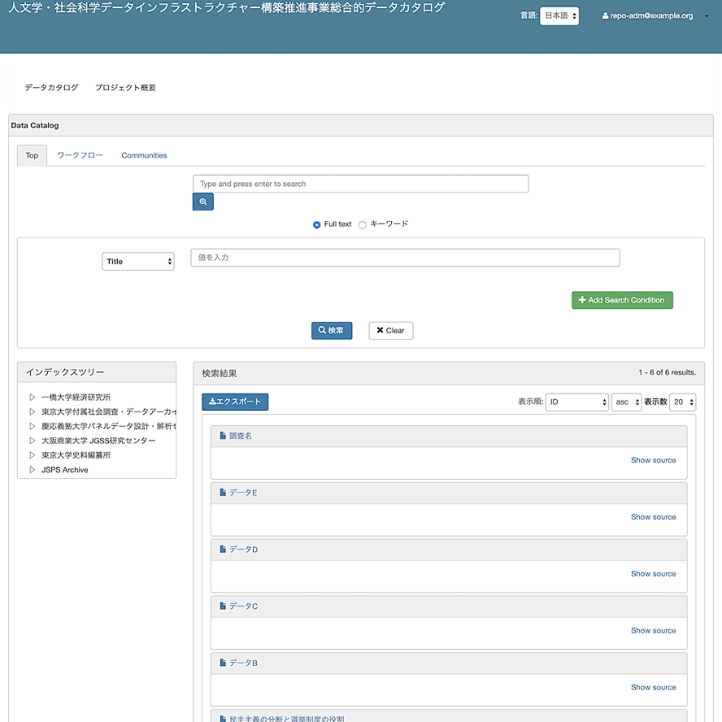
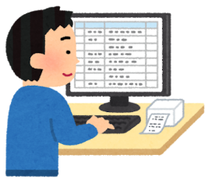

Outcomes of the Data Infrastructure Project
Guideline
JDCat (integrated cross-search system)
①Search
Metadata
Metadata
Metadata
②Accessing
Data
③Computing
Data
Depositing
Data
Disciplinary Repository
Online analysis system
Metadata
Metadata
Metadata
Data
Data
Data
Data
Code
Code
Code
Link
Notes:
中核開発の両システムが（拠点機関の）データリポジトリを軸にして設計していることを強調

Slide 13
How Do We Share Research Data?
Guideline
JDCat (integrated cross-search system)
①Search
Metadata
Metadata
Metadata
②Accessing
Data
③Computing
Data
Depositing
Data
Disciplinary Repository
Online analysis system
Metadata
Metadata
Metadata
Data
Data
Data
Data
Code
Code
Code
Link
Notes:
中核開発の両システムが（拠点機関の）データリポジトリを軸にして設計していることを強調

Slide 14

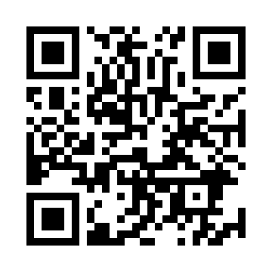
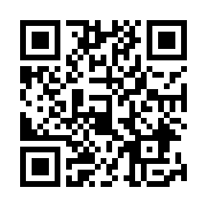
How Do We Share Research Data?
Guidelines for Sharing Data in the Humanities
JSPS 人文学・社会科学におけるデータ共有のための手引き (Japanese Only)
ALLEA Sustainable and FAIR Data Sharing in the Humanities
ALLEA: Europe’s academy federation; guidance on research integrity & open science
→The importance of creating a data management plan (DMP)
https://www.jsps.go.jp/j-di/guide.html
https://repository.dri.ie/catalog/tq582c863

Slide 15
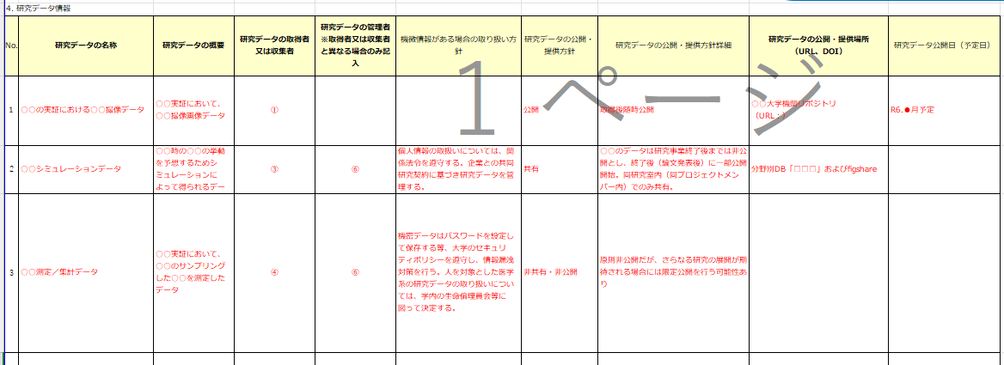
Data Management Plan (DMP)
A plan that defines how data generated during the project will be collected, managed, and shared/published.
Updated as the project progresses.
Necessary to clarify project management and resource allocation.
From FY2024, a DMP is mandatory for all JSPS KAKEN-HI grant categories.
Ref：JSPS 2024 「科学研究費助成事業データマネジメントプラン（DMP）様式例」(https://www.jsps.go.jp/file/storage/kaken_01_10_datamanagement/dmp_yoshiki_rei.xlsx)

Slide 16
Steps for Data Sharing
Planning stage
Clarify the characteristics of the data.
Distinguish primary sources vs. derived/processed data.
Identify the types of data to be produced (text, images).
Check legal/ethical constraints:
copyright, portrait rights, Cultural Property Law, etc.
In the humanities, constraints can be strong for cultural-heritage data and personal data.
→ Compile these points in a Data Management Plan (DMP).
Data collection / creation stage
Choose file formats:
prefer sustainable open formats (e.g., CSV, XML, TIFF, WAV).
Select a metadata schema that matches the nature of the dataset.

Slide 17
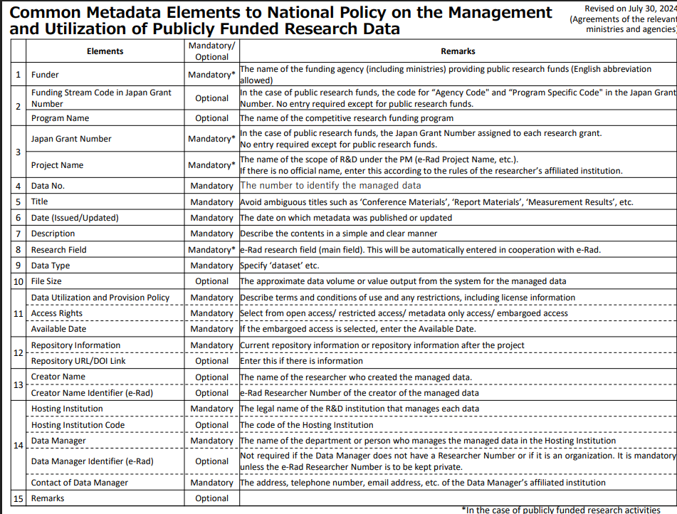
Metadata Required by Public Funders
From FY 2025, information on the supporting data for publicly funded research outputs will, in principle, be made public
Ref: https://www8.cao.go.jp/cstp/metadatainstructions_en.pdf

Slide 18
Metadata in the Humanities
In the humanities, metadata choice depends on data characteristics and repository purpose
 | Schema | Primary use | Key features
 | Dublin Core | General repository | International standard of 15 simple elements; supported by nearly all repositories.
 | schema.org | Web publishing | General-purpose schema for search engine optimization (SEO); growing use in open science contexts.
 | JPCOAR | Japanese university libraries / JDCat | Used by Japanese university libraries.
 | TEI (Text Encoding Initiative) | Literary & historical sources (text) | XML-based; strong for annotations, critical editions, and versioning; a staple of digital humanities.
 | CIDOC-CRM | Cultural heritage & museums | Event-centric ontology; suited to exhibitions, acquisition/provenance histories, and archaeological data.
 | IIIF (International Image Interoperability Framework) | Images, manuscripts, paintings | Technical framework for image delivery; ensures interoperability among viewers.
 | EAD (Encoded Archival Description) | Archival materials | Supports hierarchical archival description; widely used by archives in Europe and North America.
 | MODS/METS | Libraries | Supports bibliographic detail (MODS) and package/structural description (METS).

Slide 19
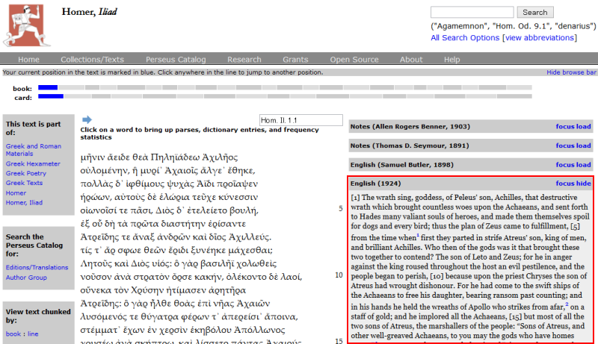
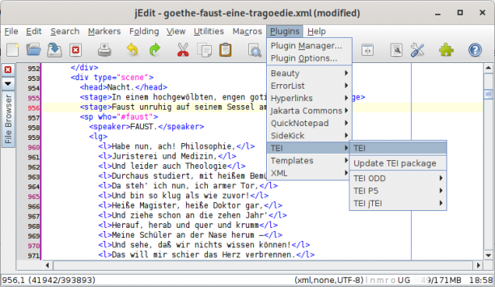
TEI (Text Encoding Initiative)
Scope
Literary works, historical sources, letters, manuscripts, dictionaries
Features
XML-based; can represent detailed structure, annotations, and edition/version differences
Strong for digital scholarly editing, critical editions, and annotation
Widely adopted across the international humanities community
Use cases
Digitized classical texts, Digital archives
TEI Editor
Perseus Digital Library

Slide 20
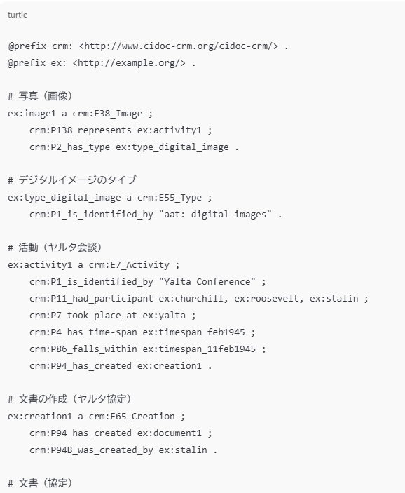
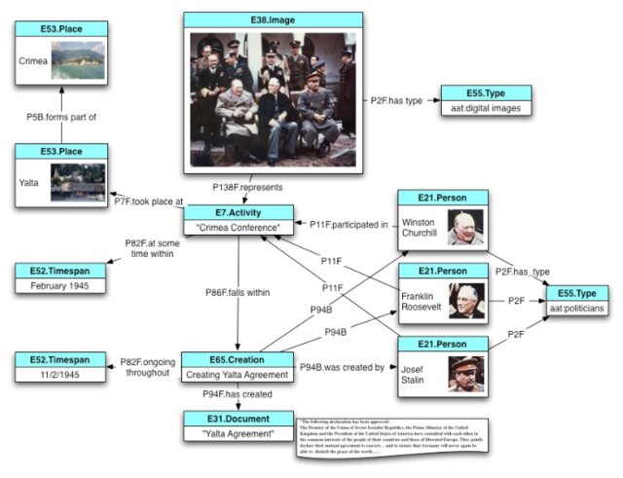
CIDOC-CRM
Scope
Museums, archaeology, and cultural-heritage archives
Features
Event-centric model — represents relationships such as acquisition, creation, and exhibition
RDF/OWL–based ontology, highly compatible with Linked Open Data
Internationally approved ISO standard (ISO 21127)
Use cases
Europeana
British Museum

Slide 21
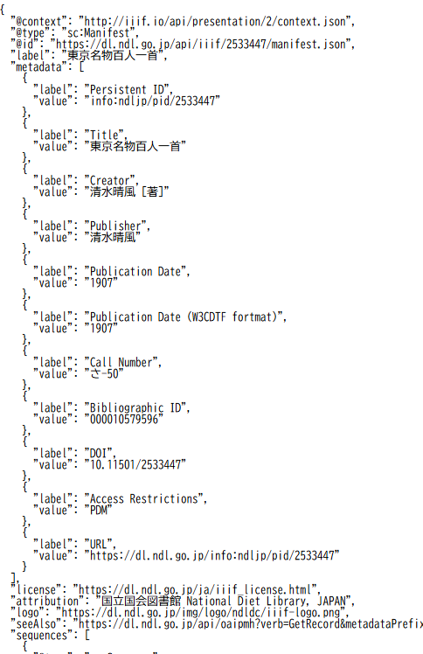
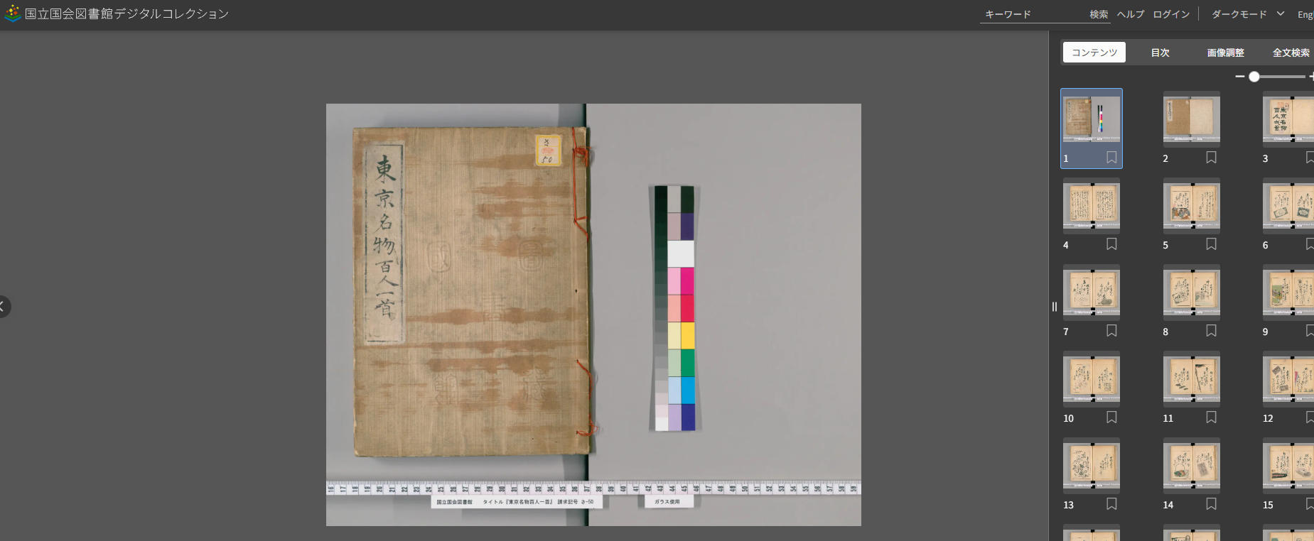
IIIF (International Image Interoperability Framework)
Scope
High-resolution images of manuscripts, paintings,
maps, photographs
Features
Supports zoom, pan, and region (partial) display
Share images across repositories via APIs
Open-source viewers available (Mirador, Universal Viewer)
Use cases
National Diet Library Digital Collections

Slide 22
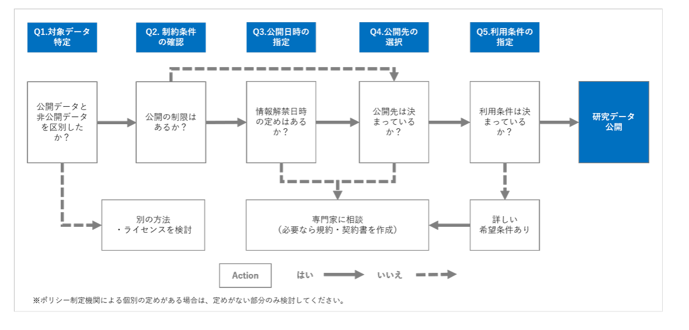
Steps for Data Sharing :After Research
Workflow for Setting Publication and Use Conditions of Research Data
Ref: “研究データの公開・利用条件表示ガイドライン”. 研究データ利活用協議会 （ RDUF ） 研 究 デ ー タ ラ イ セ ン ス 小 委 員 会 , 2020, 32p. https://doi.org/10.11502/rduf_license_guideline

Slide 23
Q1 Identify target data
Identify publishing data from the data collected or created in your project.
◯ publishing data: digital data such as numbers, text, images, audio, video.
Supporting data — released as the evidence for the article or as a research output in itself.
Source (primary) data — original data from observation/collection, held by you or by a third party.
Derived data — created by processing source data. Pay attention to citation method, rights ownership, and version information.
✕ Not publishing data
Metadata itself, research notes/lab journals, physical specimens/objects
Copyrighted works (articles, books, secondary works, etc.)
Execution environments (e.g., databases, analysis software, etc.)
mandate to publish the data?
funder, publisher, or your institution may require sharing.
→If you are unsure, consult legal/IP/ethics experts.

Slide 24
Q2 Check constraints
Check constraints before publishing
Legal / policy constraints:
state secrets & security, international treaties, protection of endangered species
Contractual constraints:
collaboration agreements, data-use agreements
Institutional policies: intellectual property (IP)
cultural property, copyright
personal data protection
If constraints exist, (Q3 handle constraints)
consider anonymization, an embargo period, and document conditions for later publish, offering condition(restricted) access
document the decision process, publish metadata only.
→ If you are unsure, consult legal/IP/ethics experts.

Slide 25
Q4 Select a repository
We recommend publishing in disciplinary or institutional repositories to improve discoverability and ensure long-term persistence.
 | Repository type | Disciplinary specialization | Support for conditional access | Persistence | Who can deposit / what is accepted | Examples
 | Disciplinary repository | Built with discipline-specific standards (e.g., TEI, IIIF). High disciplinary specialization; broad re-use expected. | Often supports conditional or restricted access. | Operated as research-center projects; long-term sustainability can be uncertain. | Tends to accept specific types of data only. | TextGridRepository Qualitative Data Repository etc.
 | Institutional repository | Generic metadata added by library staff, etc. Academic repository but low disciplinary specialization. | Limited support; often difficult to apply conditional access. | High persistence (operated by universities). | For institutional members, accepts virtually any type of data. | University institutional repositories (e.g., KURENAI); J-STAGE Data
 | General repository | Generic metadata added by individual researchers. Low specialization as academic data repositories. | Usually configurable by depositors themselves in many services. | Some persistence expected, but policies may change (e.g., fees/paywalls). | Open to anyone; accepts any data type. | Figshare Zenodo OSF Mendeley Data GitHub

Slide 26



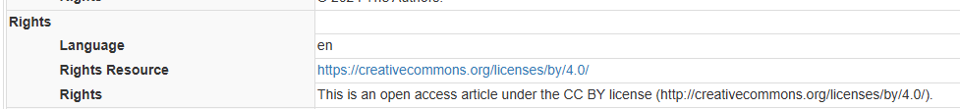
Q5. Specify terms of use (license)
1) Legal compliance
Confirm whether you are allowed to grant a license for the target data.
Consider ownership and permissions from holding institutions (e.g., manuscripts, paintings).
Do not attach a license to works already in the public domain.
If a funder or receiving repository specifies a license, follow that policy.
2) Choose a standard, maximally open license
Recommended: CC BY 4.0.
Not recommended: NC / ND
→they tend to hinder reuse, text and data mining (TDM),and derivative works.
3) Make it machine-readable
Record the machine-readable license URI in the metadata.
This improves discovery and reuse during search and harvesting.

Slide 27
Data Sharing FAQ
Where should we publish?
Disciplinary repositories are ideal when re-use is expected.
For persistence, use your university’s institutional repository.
For speed and access control, also consider a general repository.
What must we prepare to publish?
Organize information about the research data from the start of the project.
Clarify rights and permissions around the data.
Do we really have to publish?
For now, only the supporting (evidence) data for peer-reviewed articles is mandatory.
Follow an “open-and-close” strategy: open what can be open; restrict what must be restricted.
Publication needs legal and ethical care.
For culturally sensitive data (e.g., Indigenous or religious materials), build consensus with stakeholders.
Even if the data cannot be opened, publish the metadata.

Slide 28
Outlook for Data Sharing
Top-down development of the data-sharing environment
Mandates to open publicly funded research outputs
More journals adopting DAS
Research infrastructure built to support publication workflows
Via institutional repositories…
Publish evidence data (figures/tables underlying articles)
Publish metadata describing the study/project overview
Via disciplinary repositories…
Publish for re-use using IIIF and TEI metadata
Bottom-up promotion of research data sharing
Develop field-specific data-sharing guidelines
Design incentives for data contributors

Slide 29

Summary
Impact of Open Science
Public release of research outputs is advancing
across all disciplines.
More opportunities for international and
cross-disciplinary exchange.
Clearer peer-review and publication requirements.
Accountability for publicly funded research.
Research infrastructure is reshaping the research environment: – infrastructure-based support, – project management with DMPs.
What is needed for data sharing
Manage data with a Data Management Plan (DMP).
Your DMP becomes the source for publication-time metadata.
The DMP serves as documentation to judge whether data can be opened.
To build a better sharing environment, communities should revisit incentives and rules for data release.

Slide 30
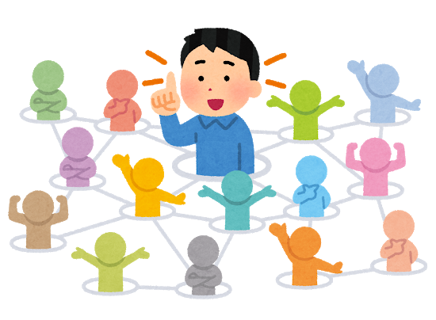

Thank you for your attention.
https://rcos.nii.ac.jp/
asaoka@nii.ac.jp
For consultations on research data publication,
please contact NII RCOS.
This presentation is based on results from the JSPS Program for Constructing Data Infrastructure for the Humanities and Social Sciences (JPJS00220180001, JPJS00218077184) and the JSPS Program for Strengthening Data Infrastructure for the Humanities and Social Sciences (JPJS00320231002).

